Slide 1
NAME :- Tanisha Negi
DATABASE:- IPL
PROJECT:- SQL
TITLE:- IPL_Auction

Slide 2
TASK 1:- Bidding on batters
[ A ] AGGRESSIVE BATTERS
Q ] Your first priority is to get 2-3 players with high S.R who have faced at least 500 balls. And to do that you have to make a list of 10 players you want to bid in the auction so that when you try to grab them in auction you should not pay the amount greater than you have in the purse for a particular player.

Slide 3
QUERY:-
SELECT
b.batsman,
SUM(b.batsman_runs)as sum_runs,
COUNT( b.ball) AS balls_faced,
round((sum(b.batsman_runs)*1.0/COUNT( b.ball)*100),2) AS strike_rate
FROM
IPL_Ball as b
WHERE
b.extras_type <> 'wides'
GROUP BY
b.batsman
HAVING
COUNT( b.ball) >= 500
ORDER BY
strike_rate desc
LIMIT
10;

Slide 4
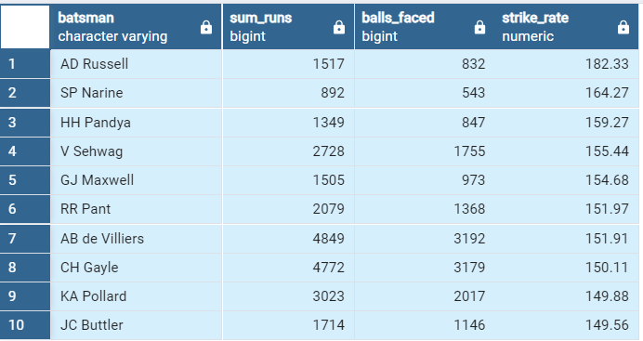
OUTPUT:- Top 10 Aggressive Batters

Slide 6
[ B ] ANCHOR BATTERS
Q ] Now you need to get 2-3 players with good Average who have played more than 2 ipl seasons. And to do that you have to make a list of 10 players you want to bid in the auction so that when you try to grab them in auction you should not pay the amount greater than you have in the purse for a particular player.

Slide 7
Query:-
SELECT
b.batsman,sum(b.batsman_runs)as sum_runs,sum(b.is_wicket)as dismissed,
SUM(b.batsman_runs) / NULLIF(SUM(b.is_wicket),0) as Average,
count(distinct extract(year from date_column)) as ipl_season
FROM
IPL_Ball as b
JOIN
IPL_Matches m ON b.id = m.id
GROUP BY
b.batsman
HAVING
count(distinct extract(year from date_column))>2
ORDER BY
Average DESC
LIMIT
10;

Slide 8
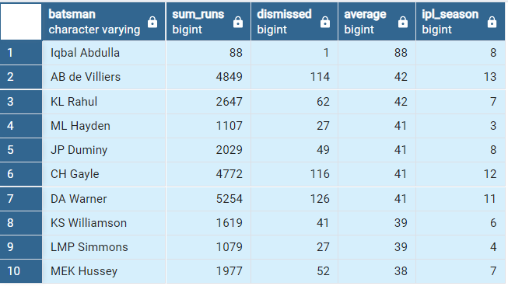
OUTPUT:- Top 10 Anchor Batters

Slide 10
[ C ] HARD HITTERS
Q ] Now you need to get 2-3 Hard-hitting players who have scored most runs in boundaries and have played more the 2 ipl season. To do that you have to make a list of 10 players you want to bid in the auction so that when you try to grab them in auction you should not pay the amount greater than you have in the purse for a particular player.

Slide 11
Query:-
SELECT
b.batsman, b.Total_runs,
round(((b.boundary_runs)*1.0 / NULLIF(b.total_runs, 0)* 100),2) AS boundary_percentage,
ipl_seasons,b.boundary_runs
FROM (
SELECT
b.batsman,
SUM(CASE WHEN b.batsman_runs = 4 OR b.batsman_runs = 6 THEN b.batsman_runs ELSE 0 END) AS boundary_runs,
SUM(b.batsman_runs) AS total_runs,
count(distinct extract(year from date_column)) as ipl_seasons
FROM
IPL_Ball as b
Join
IPL_Matches as m on b.id=m.id

Slide 12
GROUP BY
b.batsman
HAVING
count(distinct extract(year from date_column)) > 2
) AS b
ORDER BY
boundary_percentage desc
LIMIT
10;

Slide 13
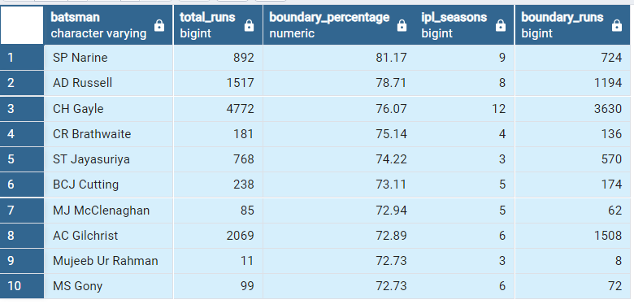
OUTPUT:- Top 10 Hard Hitters

Slide 15
TASK 2:- BIDDING ON BOWLERS
[ A ] ECONOMY BOWLERS
Q ] Your first priority is to get 2-3 bowlers with good economy who have bowled at least 500 balls in IPL so far. To do that you have to make a list of 10 players you want to bid in the auction so that when you try to grab them in auction you should not pay the amount greater than you have in the purse for a particular player.

Slide 16
Query:-
SELECT
bowler, count(over) as total_overs_bowled, sum(total_runs) as sum_runs,
Round((sum(total_runs)*1.0 / NULLIF(count(over), 0)),2) * 6 AS economy,
COUNT(DISTINCT id ) AS balls_bowled
FROM
IPL_Ball
GROUP BY
bowler
HAVING
sum(total_runs) >= 500
ORDER BY
economy asc
LIMIT
10;

Slide 17
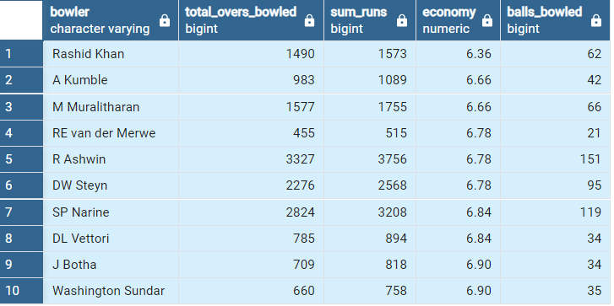
OUTPUT:- Top 10 Economy Bowlers

Slide 19
[ B ] STRIKE RATE BOWLERS
Q ] Now you need to get 2-3 bowlers with the best strike rate and who have bowled at least 500 balls in IPL so far.To do that you have to make a list of 10 players you want to bid in the auction so that when you try to grab them in auction you should not pay the amount greater than you have in the purse for a particular player.

Slide 20
Query:-
SELECT bowler,
count(bowler) as total_balls,
sum(is_wicket) as total_wicket,
Round((count(bowler)*1.0/ sum(is_wicket)*100),2) as strike_rate
FROM
Ipl_Ball
GROUP BY
bowler
HAVING
count(bowler)>500
ORDER BY
strike_rate asc
LIMIT
10;

Slide 21
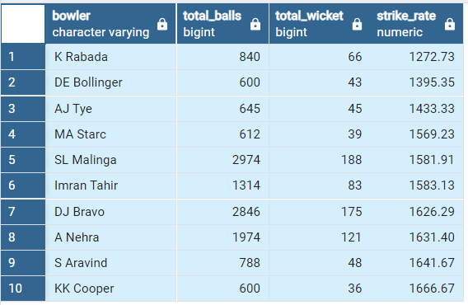
OUTPUT:- Top 10 Strike Rate Bowlers

Slide 23
TASK 3:- ALL-ROUNDERS
Q ] Now you need to get 2-3 All_rounders with the best batting as well as bowling strike rate and who have faced at least 500 balls in IPL so far and have bowled minimum 300 balls. To do that you have to make a list of 10 players you want to bid in the auction so that when you try to grab them in auction you should not pay the amount greater than you have in the purse for a particular player.

Slide 24
Query:-
SELECT
batsman as All_rounder, bowling_strike_rate,
sum(is_wicket) as total_wicket,
Round((SUM(batsman_runs)*1.0 / count(ball)*100),2) AS batting_strike_rate,
COUNT(ball) AS balls_faced,
COUNT(ball) AS balls_bowled
FROM
IPL_Ball as a
JOIN
(SELECT
bowler,
Round((count(ball)*1.0 / SUM(is_wicket)*100),2) AS bowling_strike_rate
FROM
IPL_Ball

Slide 25
GROUP BY
bowler
HAVING
COUNT(ball) >= 300
) as b ON a.batsman =b.bowler
GROUP BY
batsman,bowling_strike_rate
hAVING
count(ball)>=500
ORDER BY
batting_strike_rate desc,
bowling_strike_rate DESC
LIMIT
10;

Slide 26
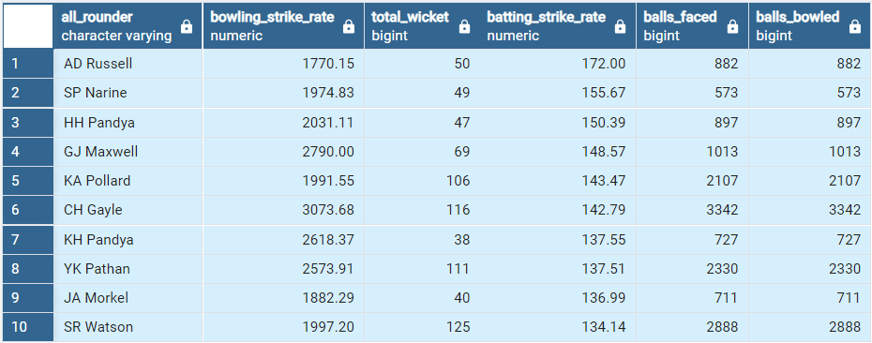
OUTPUT:- Top 10 All- Rounders

Slide 28
TASK 4:- WICKETKEEPER
Q] Suppose you are a part of the selection committee for your T20 cricket team and need to choose the ten best wicketkeepers for the upcoming IPL season. Define a criteria for selecting wicketkeepers based on their batting and wicketkeeping performance.
Your criteria should consider the following factors:
Batting Strike Rate: A wicketkeeper who can score runs quickly is important in T20 cricket. Select wicketkeepers with a batting strike rate above a certain threshold.
Runs Scored: Consider wicketkeepers who have a substantial number of runs scored in previous T20 matches.
Dismissals: A good wicketkeeper should have a high number of catches and stumpings. Select wicketkeepers who have a high number of dismissals.
Bowling Contribution: In T20 cricket, wicketkeepers may also be expected to contribute with bowling. Consider wicketkeepers who have bowled a certain number of overs and taken wickets.

Slide 29
Query:-
Step 1
CREATE TABLE Wicketkeepers AS
SELECT *,
CASE
WHEN total_runs >= 4 THEN 'boundary'
WHEN total_runs = 0 THEN 'dot'
ELSE 'other'
END AS ball_result
FROM IPL_Ball;
Step 2
Select*from wicketkeepers;

Slide 30
Final query
SELECT
wicketkeeper,
AVG(batting_strike_rate) AS avg_batting_strike_rate,
SUM(total_runs) AS total_runs_scored,
SUM(total_dismissals) AS total_dismissals,
SUM(bowled_overs) AS total_bowled_overs,
SUM(wickets_taken) AS total_wickets_taken
FROM (
SELECT
batsman AS wicketkeeper,
Round((SUM(batsman_runs) * 1.0 / SUM(ball)*100),2) AS batting_strike_rate,
SUM(batsman_runs) AS total_runs,
SUM(CASE WHEN dismissal_kind IN ('caught', 'stumped') THEN 1 ELSE 0 END) AS total_dismissals,

Slide 31
MAX(over) AS bowled_overs,
SUM(CASE WHEN dismissal_kind = 'bowled' THEN 1 ELSE 0 END) AS wickets_taken
FROM
wicketkeepers
GROUP BY
batsman
) AS filtered_wicketkeepers
GROUP BY
wicketkeeper
ORDER BY
avg_batting_strike_rate DESC,
total_runs_scored DESC,
total_dismissals DESC,
total_bowled_overs DESC,
total_wickets_taken DESC
LIMIT 10;

Slide 32
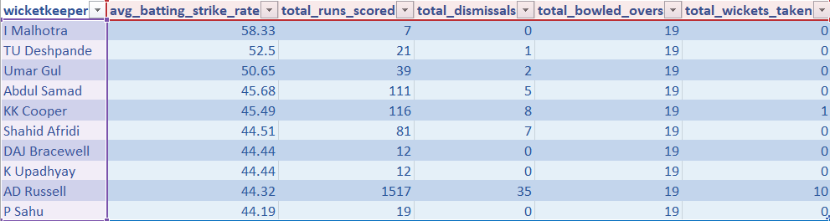
OUTPUT:- Top 10 wicketkeepers

Slide 33
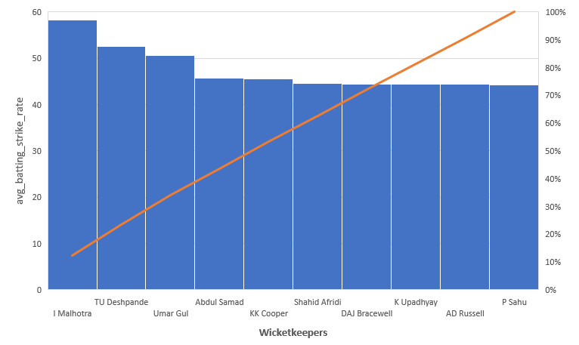

Slide 34
TASK 5 Additional Questions for Final Assessment
Queries to create “IPL_Ball” Table.
create table IPL_Ball(
id int,inning int,over int,ball int,
batsman varchar,non_striker varchar,bowler varchar,
batsman_runs int,extra_runs int,total_runs int ,is_wicket int,
dismissal_kind varchar,player_dismissed varchar,fielder varchar,
extras_type varchar,batting_team varchar,bowling_team varchar);
copy IPL_Ball from 'C:\Program Files\PostgreSQL\12\data\IPL Dataset\IPL_Ball.csv' delimiter',' csv header;
select *from IPL_Ball;

Slide 35
Queries to create “IPL_Matches” Table.
Create table IPL_Matches(
id int, city varchar, date_column ,
player_of_match varchar, venue varchar,
neutral_venue int,team1 varchar, team2 varchar, toss_winner varchar, toss_decision varchar, winner varchar, result varchar,
result_margin int, eliminator varchar, method varchar,
umpire1 varchar, umpire2 varchar);
copy IPL_Matches from 'C:\Program Files\PostgreSQL\12\data\IPL Dataset\IPL_Matches.csv' delimiter',' csv header;

Slide 36

Additional Questions for Final Assessment
Q 1] Get the count of cities that have hosted an IPL match.
SELECT COUNT(DISTINCT city) FROM ipl_Matches; Ouput:-
Q2 ] Create table deliveries_v02 with all the columns of the table ‘deliveries’ and an additional column ball_result containing values boundary, dot or other depending on the total_run (boundary for >= 4, dot for 0 and other for any other number) .
CREATE TABLE deliveries_v02 AS
SELECT *,
CASE
WHEN total_runs >= 4 THEN 'boundary'
WHEN total_runs = 0 THEN 'dot'
ELSE 'other'
END AS ball_result
FROM IPL_Ball;
Select * From deliveries_v02;

Slide 37

Q 3] Write a query to fetch the total number of boundaries and dot balls from the deliveries_v02 table.
SELECT
SUM(CASE WHEN batsman_runs = 4 OR batsman_runs = 6 THEN 1 ELSE 0 END) AS Total_Boundaries,
SUM(CASE WHEN batsman_runs = 0 THEN 1 ELSE 0 END) AS Total_Dot_Balls
FROM
deliveries_v02;
Output:-
Q4 ] Write a query to fetch the total number of boundaries scored by each team from the deliveries_v02 table and order it in descending order of the number of boundaries scored.
SELECT batting_team, COUNT(*) AS total_boundaries
FROM deliveries_v02
WHERE ball_result = 'boundary'
GROUP BY batting_team
ORDER BY total_boundaries DESC;

Slide 38
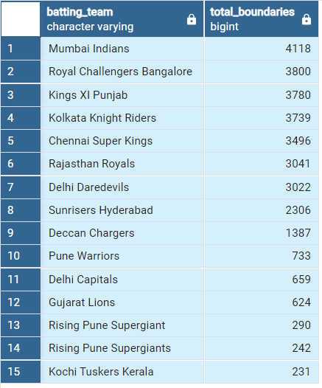
Output :-

Slide 39
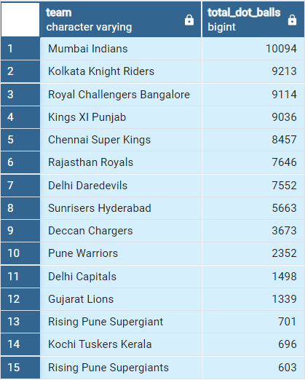
Q 5 ] Write a query to fetch the total number of dot balls bowled by each team and order it in descending order of the total number of dot balls bowled.
SELECT
batting_team AS Team,
SUM(CASE WHEN batsman_runs = 0 THEN 1 ELSE 0 END) AS Total_Dot_Balls
FROM
Deliveries_v02
GROUP BY
batting_team
ORDER BY
Total_Dot_Balls DESC;
Output:-

Slide 40
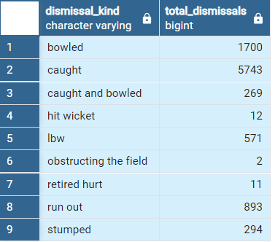
Q 6] Write a query to fetch the total number of dismissals by dismissal kinds where dismissal kind is not NA.
SELECT
dismissal_kind,
COUNT(*) AS Total_Dismissals
FROM
Deliveries_v02
WHERE
dismissal_kind IS NOT NULL
AND dismissal_kind <> 'NA'
GROUP BY
dismissal_kind;
Output:-

Slide 41
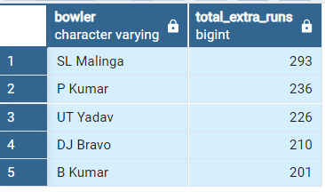
Q 7] Write a query to get the top 5 bowlers who conceded maximum extra runs from the deliveries table.
SELECT bowler,
SUM(extra_runs) AS total_extra_runs
FROM
deliveries_v02
GROUP BY
bowler
ORDER BY
total_extra_runs DESC
LIMIT
5;
Output:-

Slide 42
Q8] Write a query to create a table named deliveries_v03 with all the columns of deliveries_v02 table and two additional column (named venue and date_column) of venue and date from table matches.
CREATE TABLE deliveries_v03 AS
SELECT
dv.*,
m.city AS venue,
m.date_column
FROM
deliveries_v02 as dv
JOIN
IPL_Matches AS m ON dv.id = m.id;
select * From deliveries_v03;

Slide 43
Q9] Write a query to fetch the total runs scored for each venue and order it in the descending order of total runs scored.
SELECT venue,
SUM(total_runs) AS total_runs_scored
FROM
deliveries_v03
GROUP BY
venue
ORDER BY
total_runs_scored DESC;
Output:-
venue | total_runs_scored
Mumbai | 32042
Kolkata | 23658
Delhi | 22947
Bangalore | 20237
Hyderabad | 19484
Chandigarh | 18008
Chennai | 17821
Jaipur | 14264
Pune | 11535
Abu Dhabi | 8830
Dubai | 8338
Bengaluru | 5127
Durban | 4353
Sharjah | 4095
NA | 3893
Visakhapatnam | 3746
Ahmedabad | 3746
Centurion | 3653
Rajkot | 3316
Dharamsala | 2897
Indore | 2872
Johannesburg | 2292
Cuttack | 2278
Ranchi | 2056
Port Elizabeth | 2033
Cape Town | 1764
Raipur | 1741
Kochi | 1363
Kanpur | 1298
Kimberley | 897
Nagpur | 882
East London | 799
Bloemfontein | 529

Slide 44
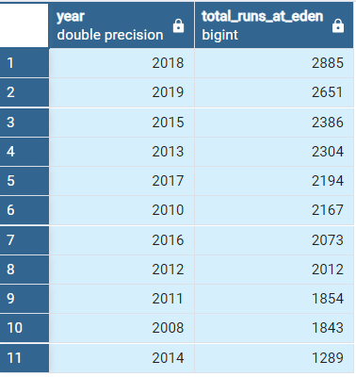
Q10] Write a query to fetch the year-wise total runs scored at Eden Gardens and order it in the descending order of total runs scored.
SELECT
EXTRACT(YEAR FROM m.date_column) AS year,
SUM(d.total_runs) AS total_runs_at_eden
FROM
IPL_Matches AS m
JOIN
deliveries_v03 AS d ON m.id = d.id
WHERE
m.venue = 'Eden Gardens'
GROUP BY
year
ORDER BY
total_runs_at_eden DESC;

Slide 45
THANK YOU

